Slide 1
AI-Powered Expenses Analyzer

Slide 2
ABSTRACT
AI-Powered Expenses Analyzer is a web-based personal finance management system developed using Java, JSP, Servlets, JDBC, and MySQL.
The system helps users record income and expenses, generate daily/monthly/yearly reports, and view financial insights through charts.
It also includes an AI-style bill scanning feature that extracts amount, date, and category from OCR text or bill images.
The project improves expense tracking accuracy, reduces manual effort, and supports better financial decision-making.

Slide 3
INTRODUCTION
Managing daily income and expenses manually is difficult and often leads to missing records and poor financial planning.
Many users do not have a simple system to monitor spending patterns, savings, and category-wise expenses.
This project provides a centralized platform to store, manage, analyze, and review financial transactions.
It combines finance tracking, report generation, and OCR-based bill extraction in a single system.

Slide 4
OBJECTIVE
To develop a user-friendly system for recording personal income and expenses.
To generate daily, monthly, and yearly financial reports automatically.
To analyze spending patterns using charts and summary metrics.
To reduce manual entry effort using bill text/image extraction.
To help users improve savings and financial planning.

Slide 5
EXISTING SYSTEM
Traditional expense tracking is usually done using notebooks, spreadsheets, or manual calculations.
Users must enter every transaction manually and calculate totals separately.
Existing manual methods do not provide instant reports or category-wise analysis.
Bill details also need to be typed manually, which takes time.

Slide 6
DIS ADVANTAGES
High chance of human error in manual entries and calculations.
No automatic report generation or visual analysis.
Difficult to identify overspending categories and savings trends.
Time-consuming process for managing monthly financial data.
No bill scanning or smart extraction support.

Slide 7
PROPOSED SYSTEM
The proposed system is a web application that allows users to log in and manage their income and expenses efficiently.
It stores data in a database and provides report generation based on date, month, and year.
It includes analysis features such as category-wise expense charts and monthly comparisons.
It also offers AI-style bill scan functionality using OCR text extraction and rule-based category identification.
The system is built with MySQL as the primary database and H2 as a fallback database.

Slide 8
ADVANTAGES
Easy and organized income-expense management.
Automatic financial report generation.
Visual analysis through pie, bar, and line charts.
Faster bill entry using OCR-based extraction.
Secure session-based user access.
MySQL with H2 fallback improves reliability during demo/testing.

Slide 9
WORKING ENVIRONMENT
Operating System: Windows 10 / Windows 11
Development IDE: Eclipse IDE for Enterprise Java
Programming Language: Java 21
Web Technology: JSP, Servlet, HTML, CSS, JavaScript
Web Server: Apache Tomcat 9
Database: MySQL 8 with H2 fallback
Browser: Google Chrome / Microsoft Edge

Slide 10
SOFTWARE REQUIREMENTS
JDK 21
Apache Tomcat 9
MySQL Server 8+
Eclipse IDE for Enterprise Java Developers
JDBC Driver for MySQL
H2 Database JAR
Chart.js library
Tesseract OCR for image-based bill extraction

Slide 11
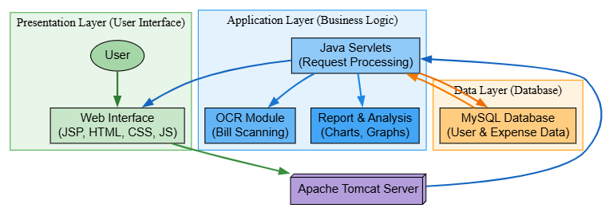
ARCHITECTURE DIAGRAM

Slide 12
MODULE DESCRIPTION
1. DATA COLLECTION MODULE
This module collects financial data from the user through forms and bill uploads.
Users can enter income details such as amount, source, and date.
Users can enter expense details such as amount, category, and date.
The system also accepts OCR text files or bill images for extracting expense information.
2. DATA PREPROCESSING MODULE
The collected data is validated before storing in the database.
Amount values are checked and date values are normalized into standard format.
OCR text is cleaned and scanned to identify useful fields.
The system prepares structured data for report generation and analysis.

Slide 13
3. MODEL TRAINING MODULE
This project does not use a heavy machine learning training model.
Instead, it uses rule-based AI-style logic for bill understanding.
Pattern matching is used to identify amount and date from OCR text.
Keyword-based scoring is used to guess the expense category such as Food, Travel, Groceries, or Utilities.
This approach keeps the system simple, fast, and suitable for academic demonstration.
4. PREDICTION MODULE
The system predicts or suggests the expense category from bill text.
It identifies highest spending categories and monthly trends through analysis logic.
It calculates net savings by comparing total income and total expenses.
This helps users understand financial behavior and plan future budgets better.

Slide 14
5. FRONTEND MODULE
The frontend is developed using JSP, HTML, CSS, and JavaScript.
It includes pages such as Login, Dashboard, Income, Expense, Report, Analysis, Bill Scan, and Profile.
The interface supports user interaction, form submission, data viewing, and navigation between modules.
It also displays charts and live visual summaries for better user understanding.

Slide 15
CONCLUSION
The AI-Powered Expenses Analyzer successfully provides a complete solution for personal finance tracking.
It simplifies income and expense management through a structured web interface.
The system generates useful reports and visual insights for better decision-making.
The bill scan feature reduces manual effort and adds smart functionality to the project.
Overall, the project is practical, user-friendly, and suitable for real-world and academic use.

Slide 16
FUTURE WORK
Add password encryption using BCrypt for better security.
Introduce budget alerts and overspending notifications.
Generate PDF and Excel export reports.
Improve OCR accuracy using advanced AI/ML models.
Add mobile application support.
Integrate bank SMS or UPI transaction import.
Provide multi-user admin dashboard and role-based access control.

Slide 17


